Slide 1


PROJECT-BASED LEARNING (PBL) INITIATIVE 15-DAY HYBRID TECH FUSION HACKATHON 2026 AI Systems for Visual Intelligence Project Title
Team No-8
2320030402 – G. Sai Abhiram Reddy
2320030294 – PLV Abhiram
2320030287 – K. Dilip
Department of Computer Science and Engineering
KONERU LAKSHMAIAH EDUCATION FOUNDATION

Slide 2
OUTLINE
Abstract
Introduction
Objectives
Proposed Method
Implementation
Results
Conclusion

Slide 3
Abstract
Background: Agriculture needs smart decision-making for
crop selection
Objective: Predict best crop based on soil & weather
conditions
Methodology: Machine Learning (Random Forest Classifier)
Results: Accurate crop recommendations based on
input data
Conclusion: Helps farmers improve productivity using
data-driven decisions

Slide 4
Introduction
Agriculture is the backbone of many economies
Choosing the wrong crop leads to losses
Traditional methods are not data-driven
Problem:
Farmers don’t know which crop suits their soil & climate
Solution:
Build an ML-based system to recommend crops
Applications:
Smart farming
Agricultural advisory systems
Government planning tools

Slide 5
Objectives
To develop a system that predicts suitable crops using ML
To improve agricultural productivity using data analysis
To integrate weather-based recommendations
To provide a user-friendly interface for farmers

Slide 6
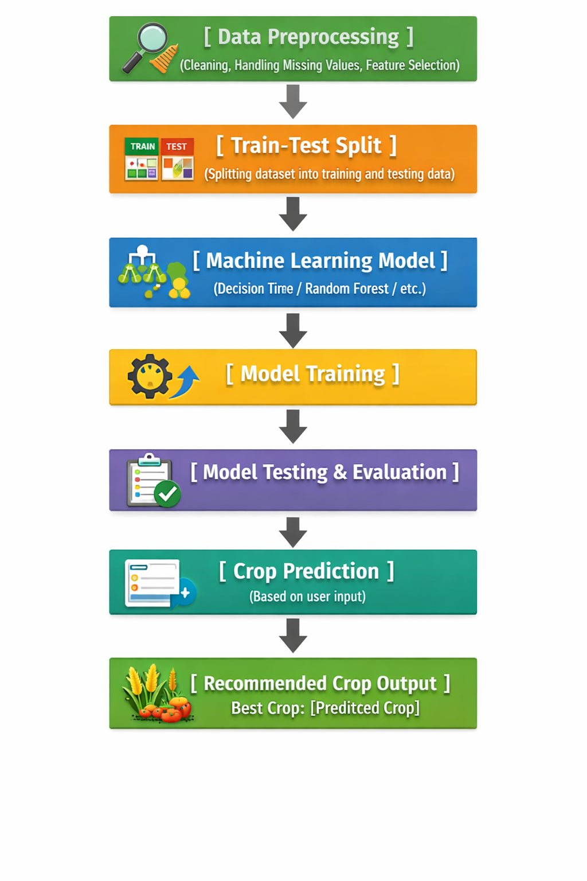
Proposed Method
Inputs:
Nitrogen (N)
Phosphorus (P)
Potassium (K)
Temperature
Humidity
pH
Rainfall
Output:
Recommended Crop

Slide 7
Implementation
Python → Easy to implement machine learning and
data processing
Scikit-learn → Provides ready-to-use ML algorithms like
Random Forest
Pandas → Used for handling and analyzing dataset (CSV files)
NumPy → Supports fast numerical computations
React (Frontend) → Creates interactive and user-friendly UI
Flask/FastAPI (Backend) → Connects frontend with ML model and handles API requests

Slide 8
Results
Model predicts crops with high accuracy (~90%+ typically)
Works well for different soil conditions
Observations:
Random Forest handles multi-feature data effectively
More stable than single decision tree

Slide 9
Conclusion
Successfully developed crop recommendation system
Helps farmers make better decisions
Reduces risk of crop failure
Limitations:
Depends on dataset quality
Doesn’t consider market demand
Future Scope:
Add real-time IoT sensors
Improve chatbot using AI
Add price prediction

Slide 10
References
Scikit-learn Documentation
Kaggle Crop Recommendation Dataset
Research papers on Smart Agriculture
GitHub project repositories
Online tutorials (YouTube, blogs)

Slide 11
THANK YOU

